Slide 1

Reccurent Neural Network
201920951 Dept.Software JuannKim

Slide 2
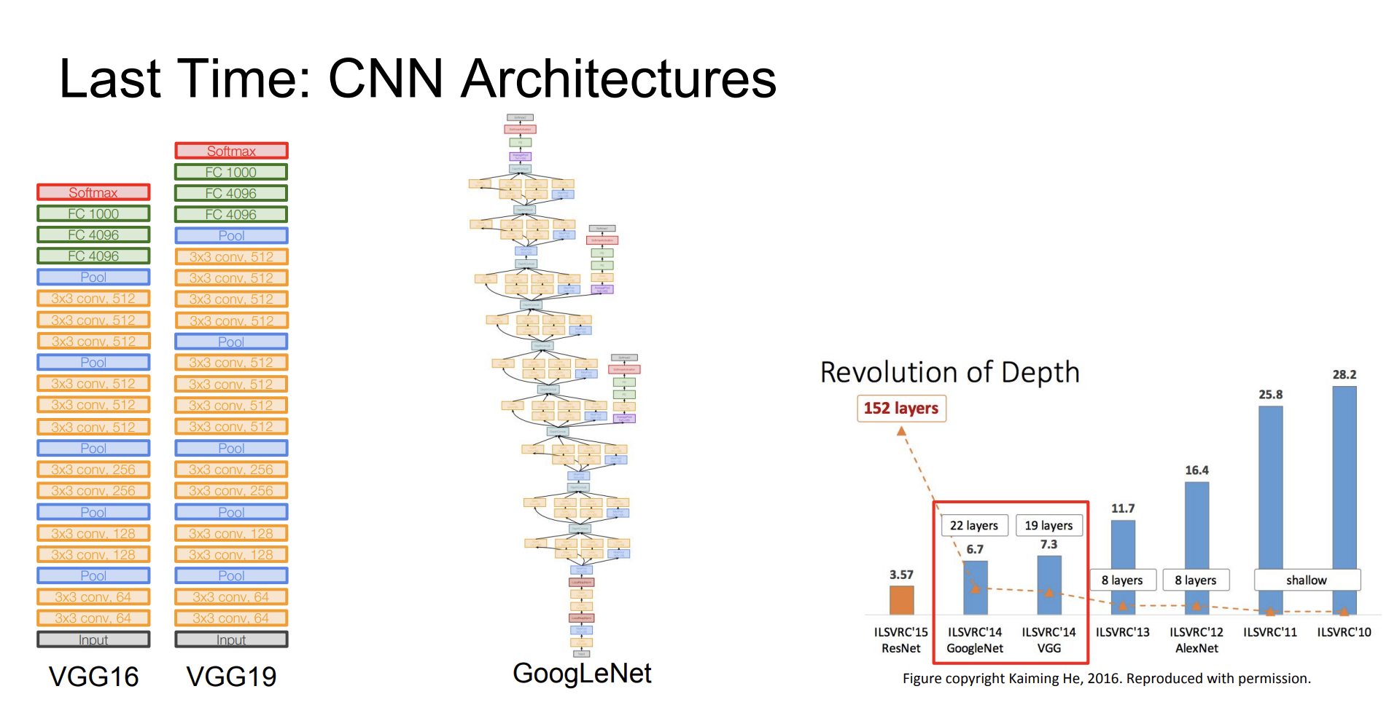

Slide 3
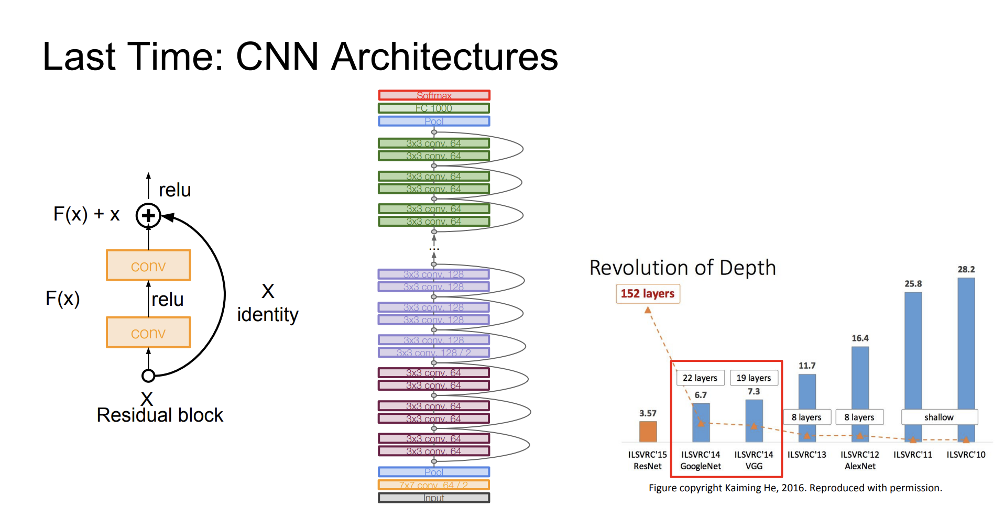

Slide 4
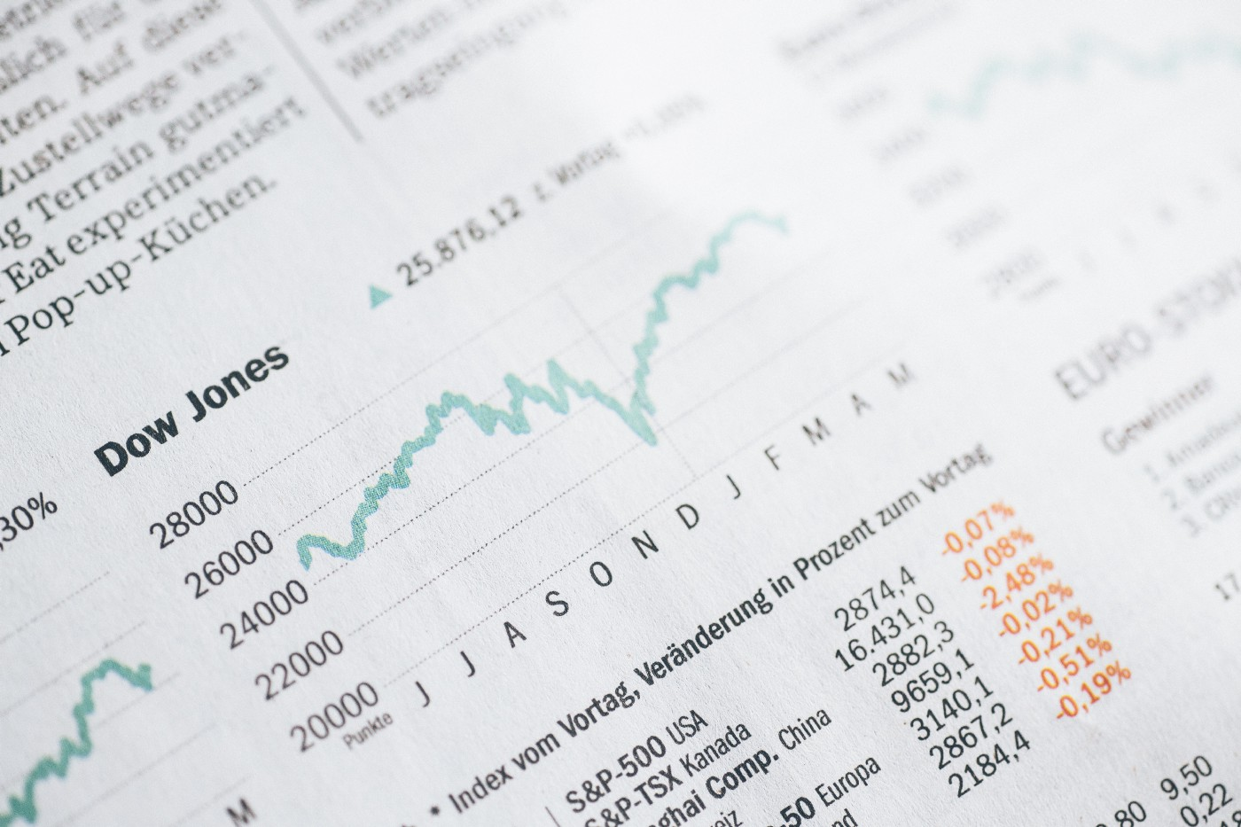
What is sequential data?
Whenever the points in the dataset are dependent on the other points in the dataset the data is said to be Sequential data.
A common example of this is a Timeseries such as a stock price or a sensor data where each point represents an observation at a certain point in time.

Slide 5
Property of Sequential data
요소의 순서가 중요하다
샘플의 길이가 다르다
문맥 의존성을 지닌다
계절성을 가지는 데이터가 많다

Slide 6
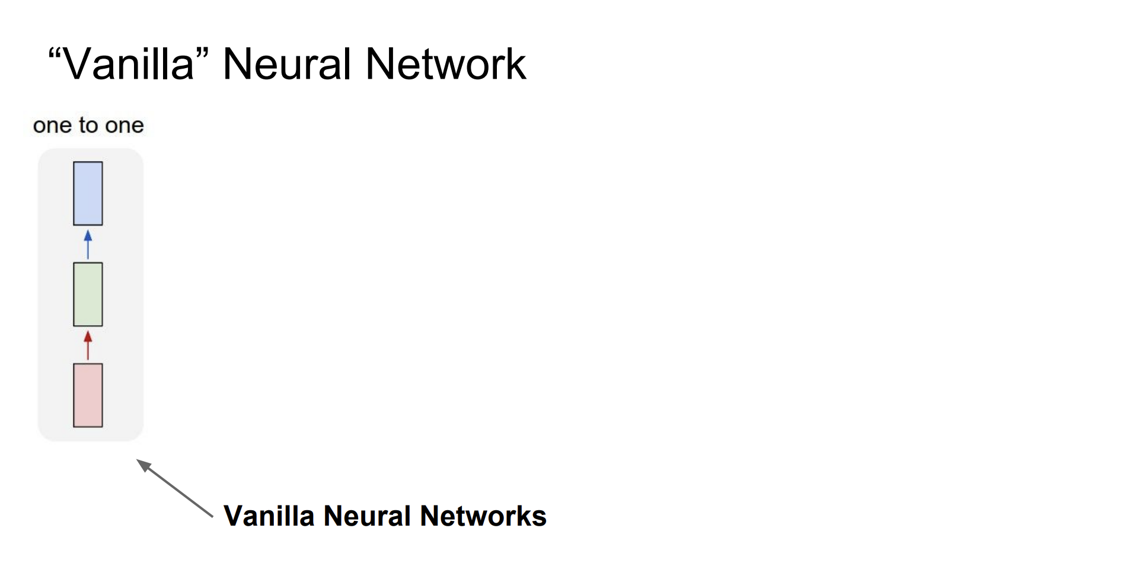

Slide 7
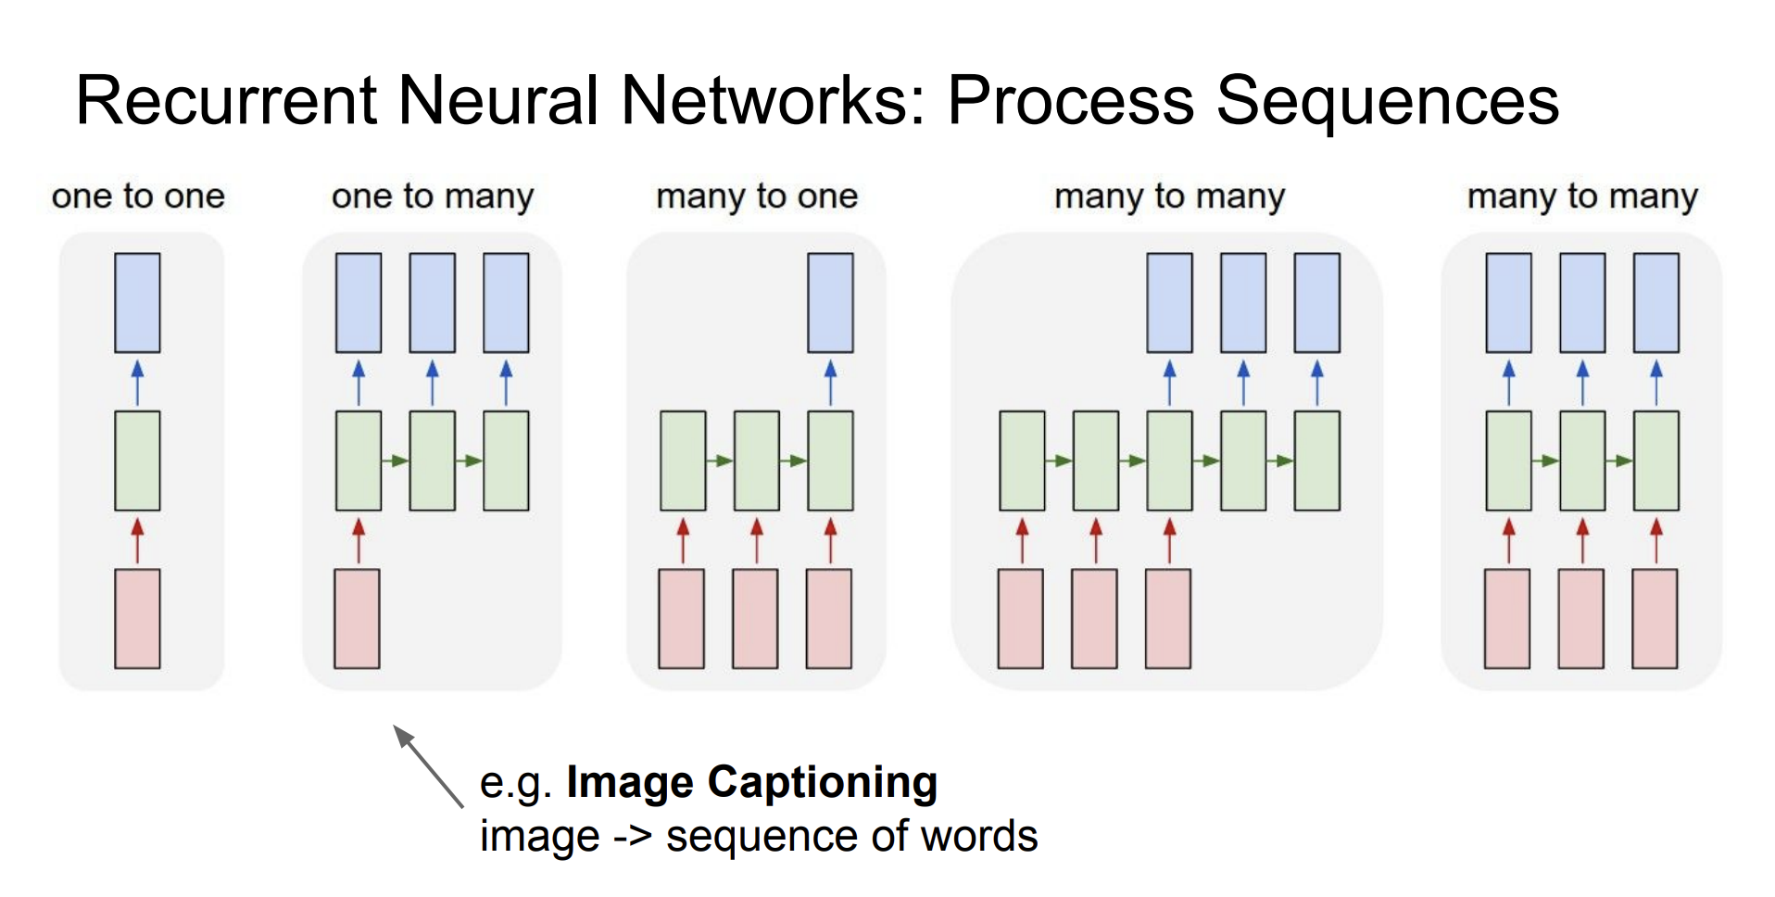

Slide 8
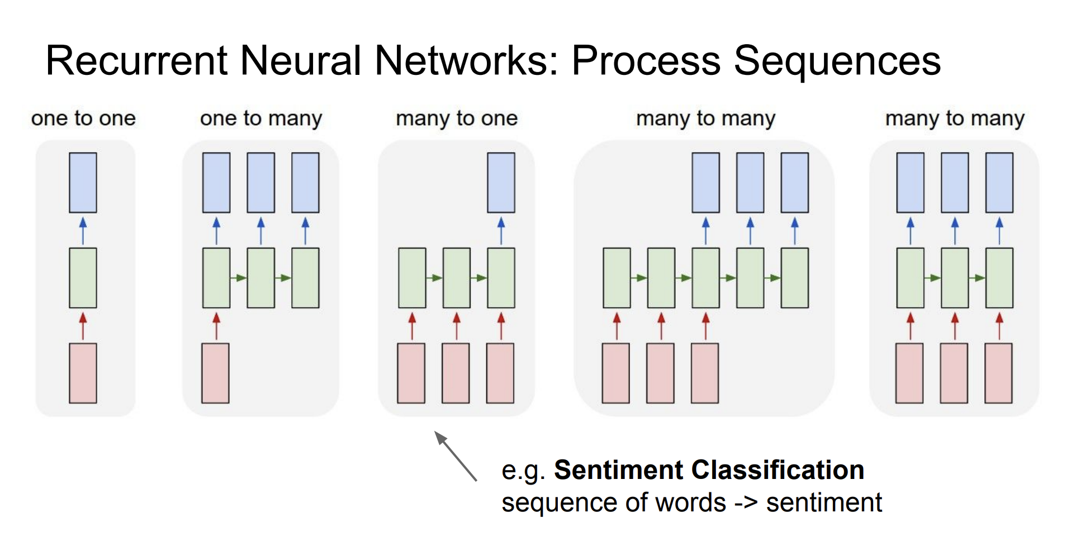

Slide 9
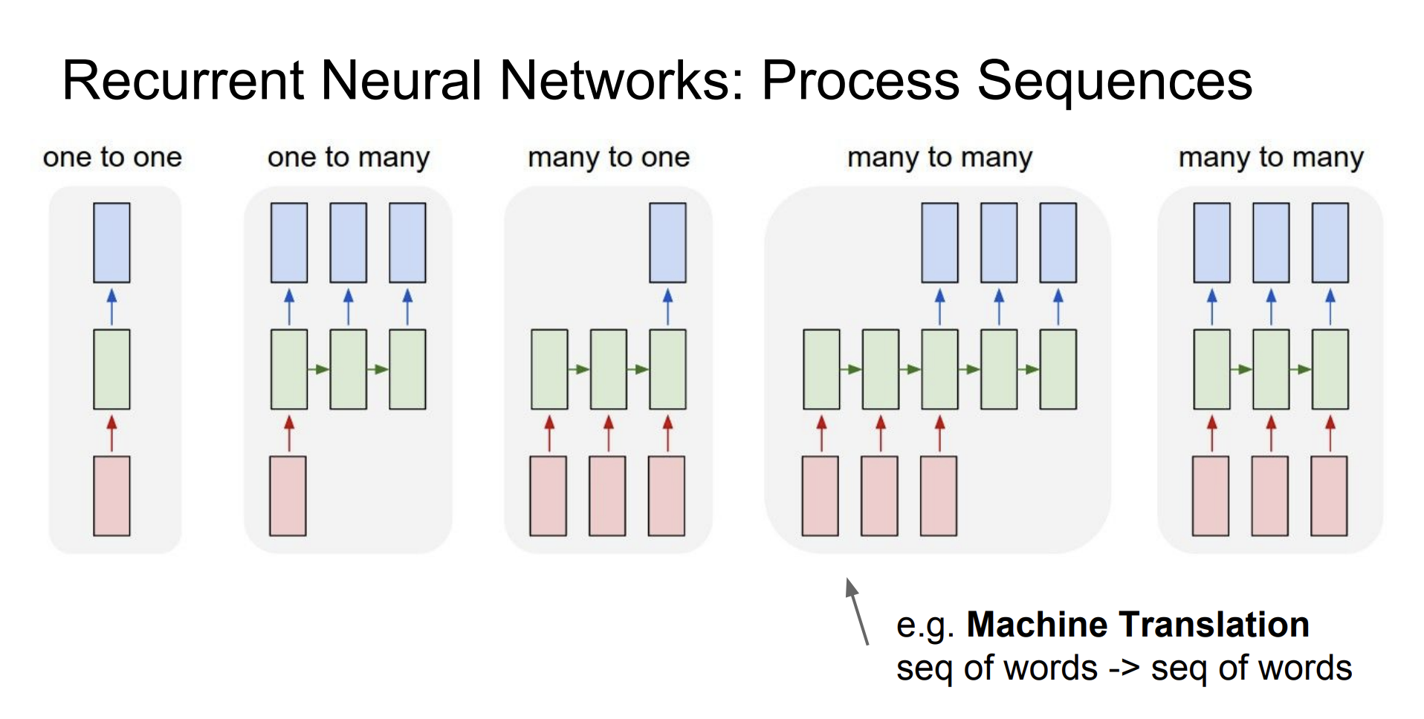

Slide 10
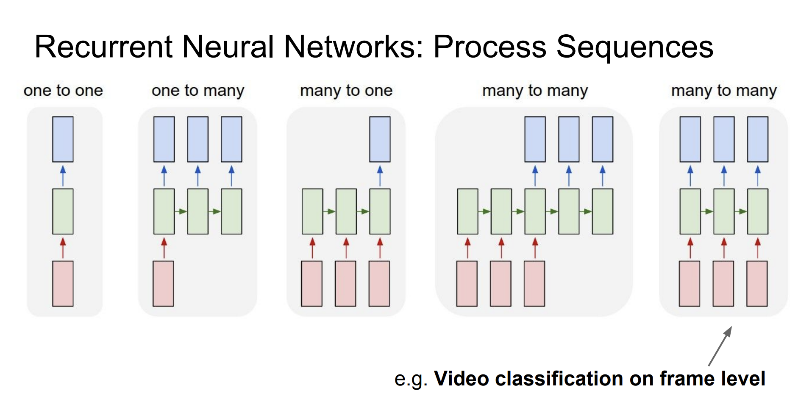

Slide 11
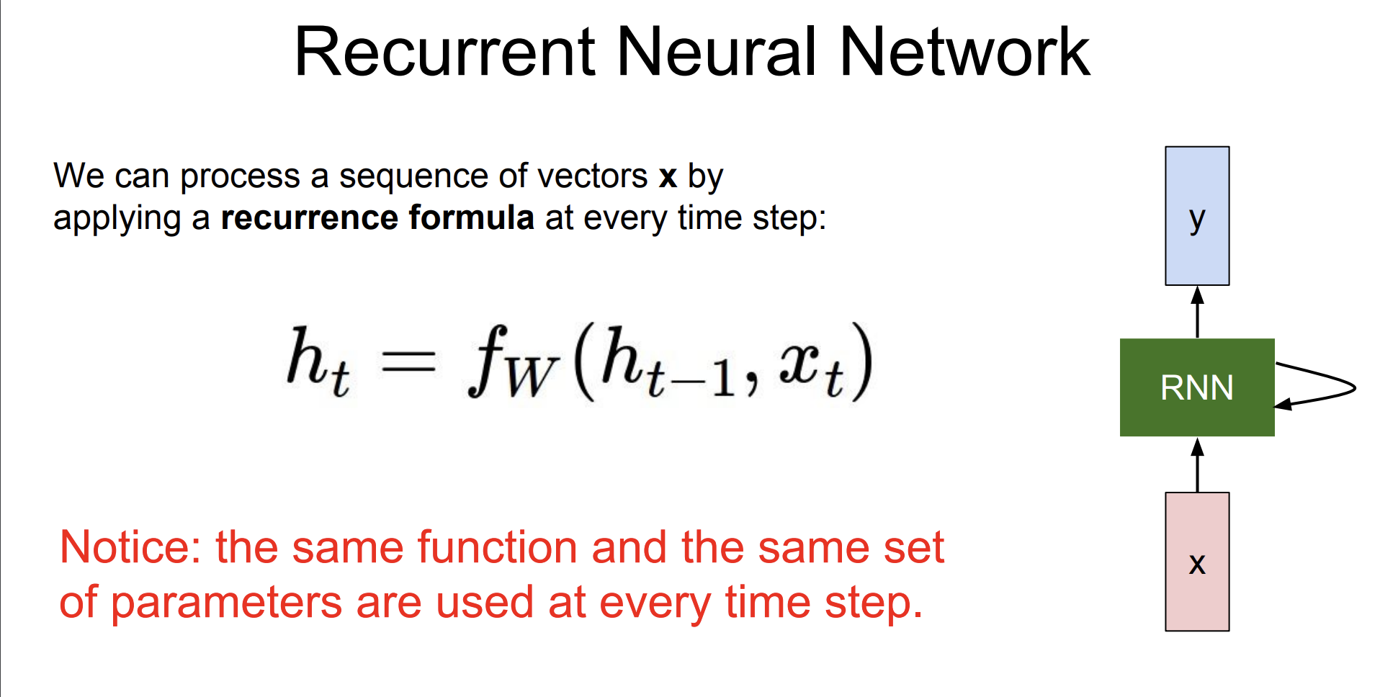

Slide 12
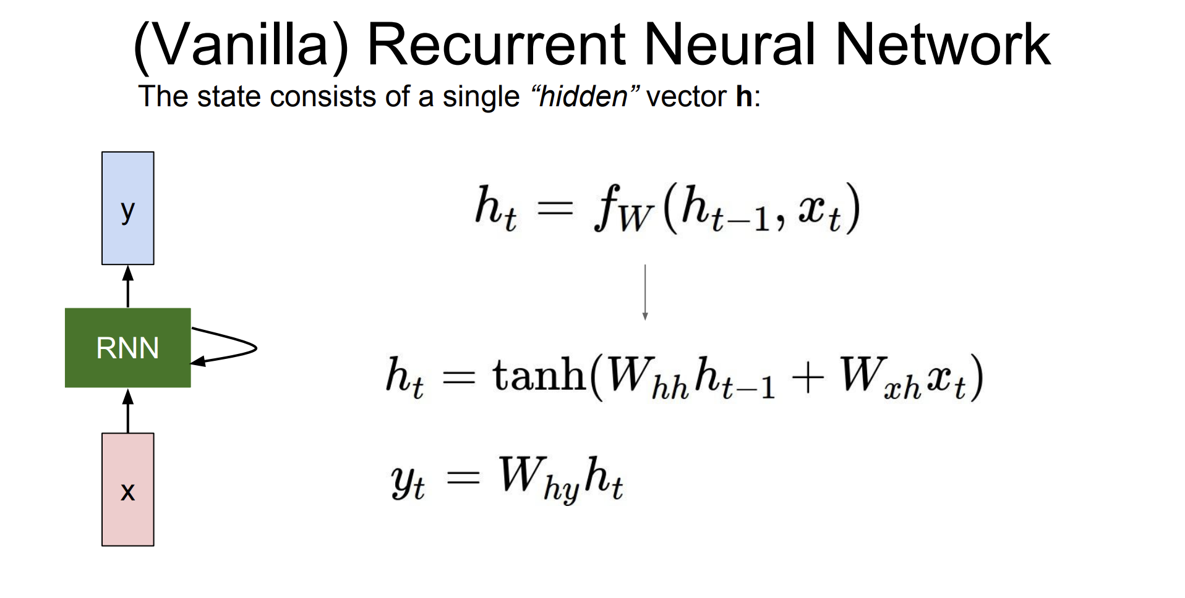

Slide 13
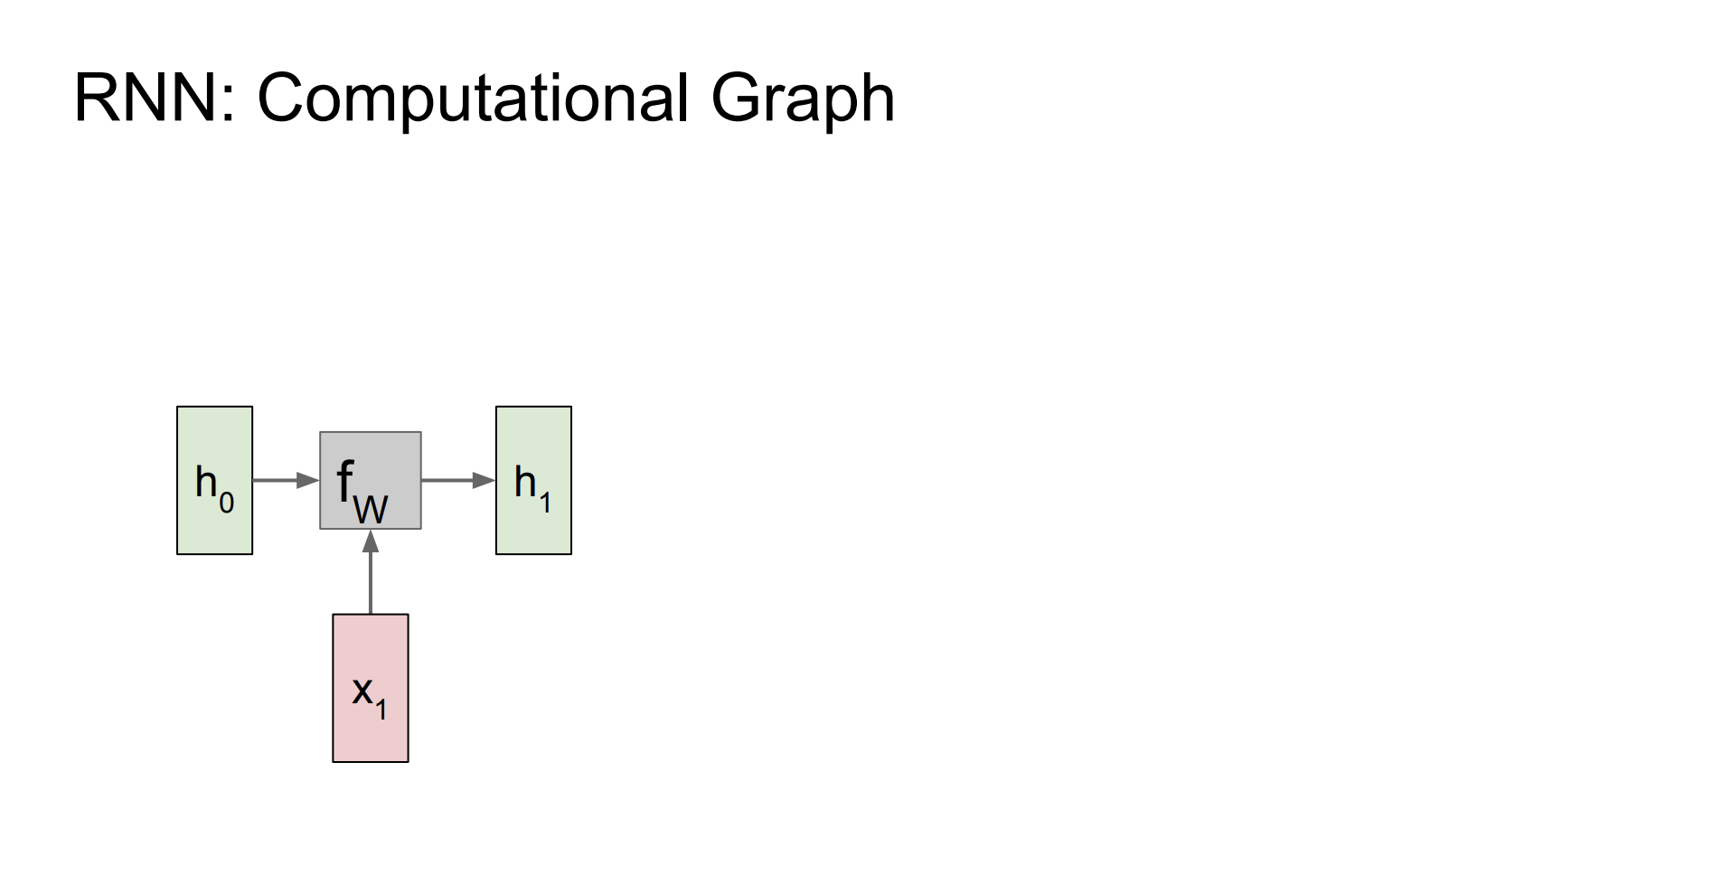

Slide 14
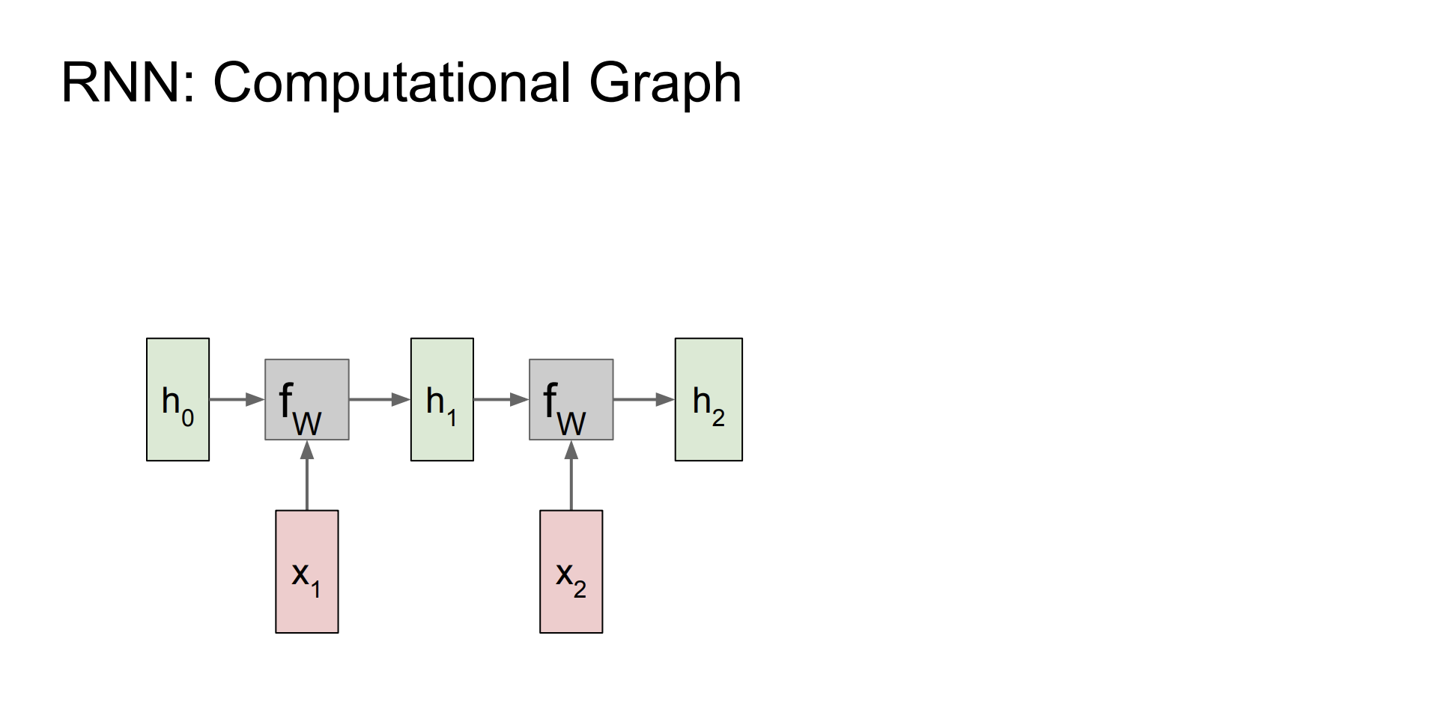

Slide 15
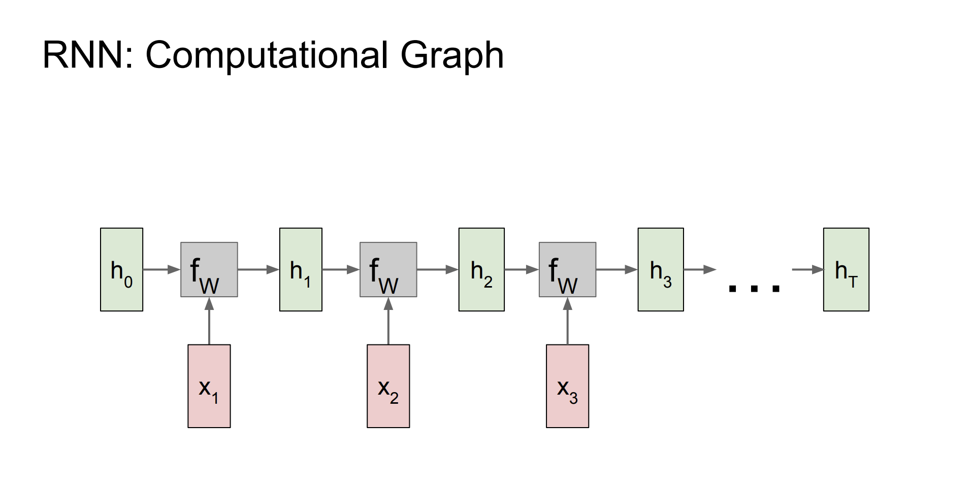

Slide 16
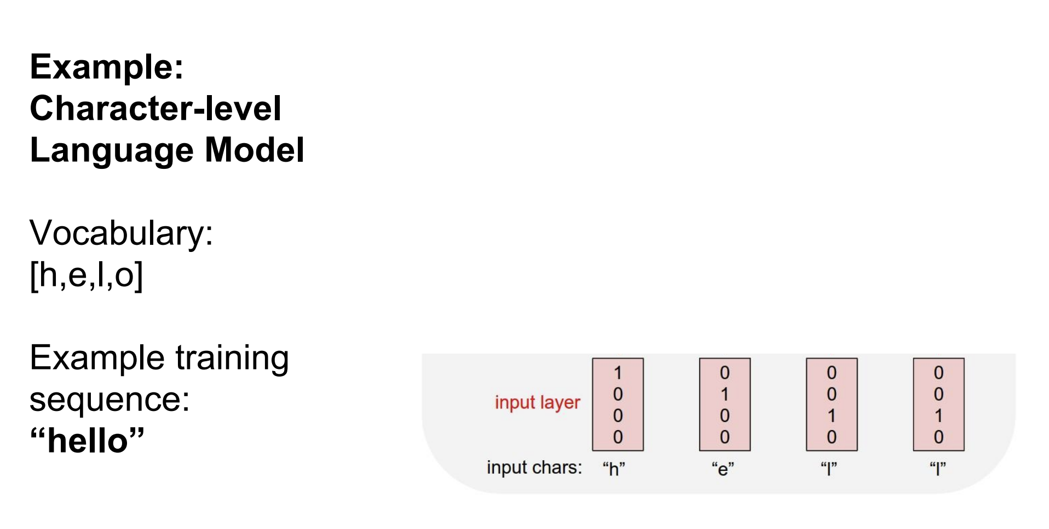

Slide 17
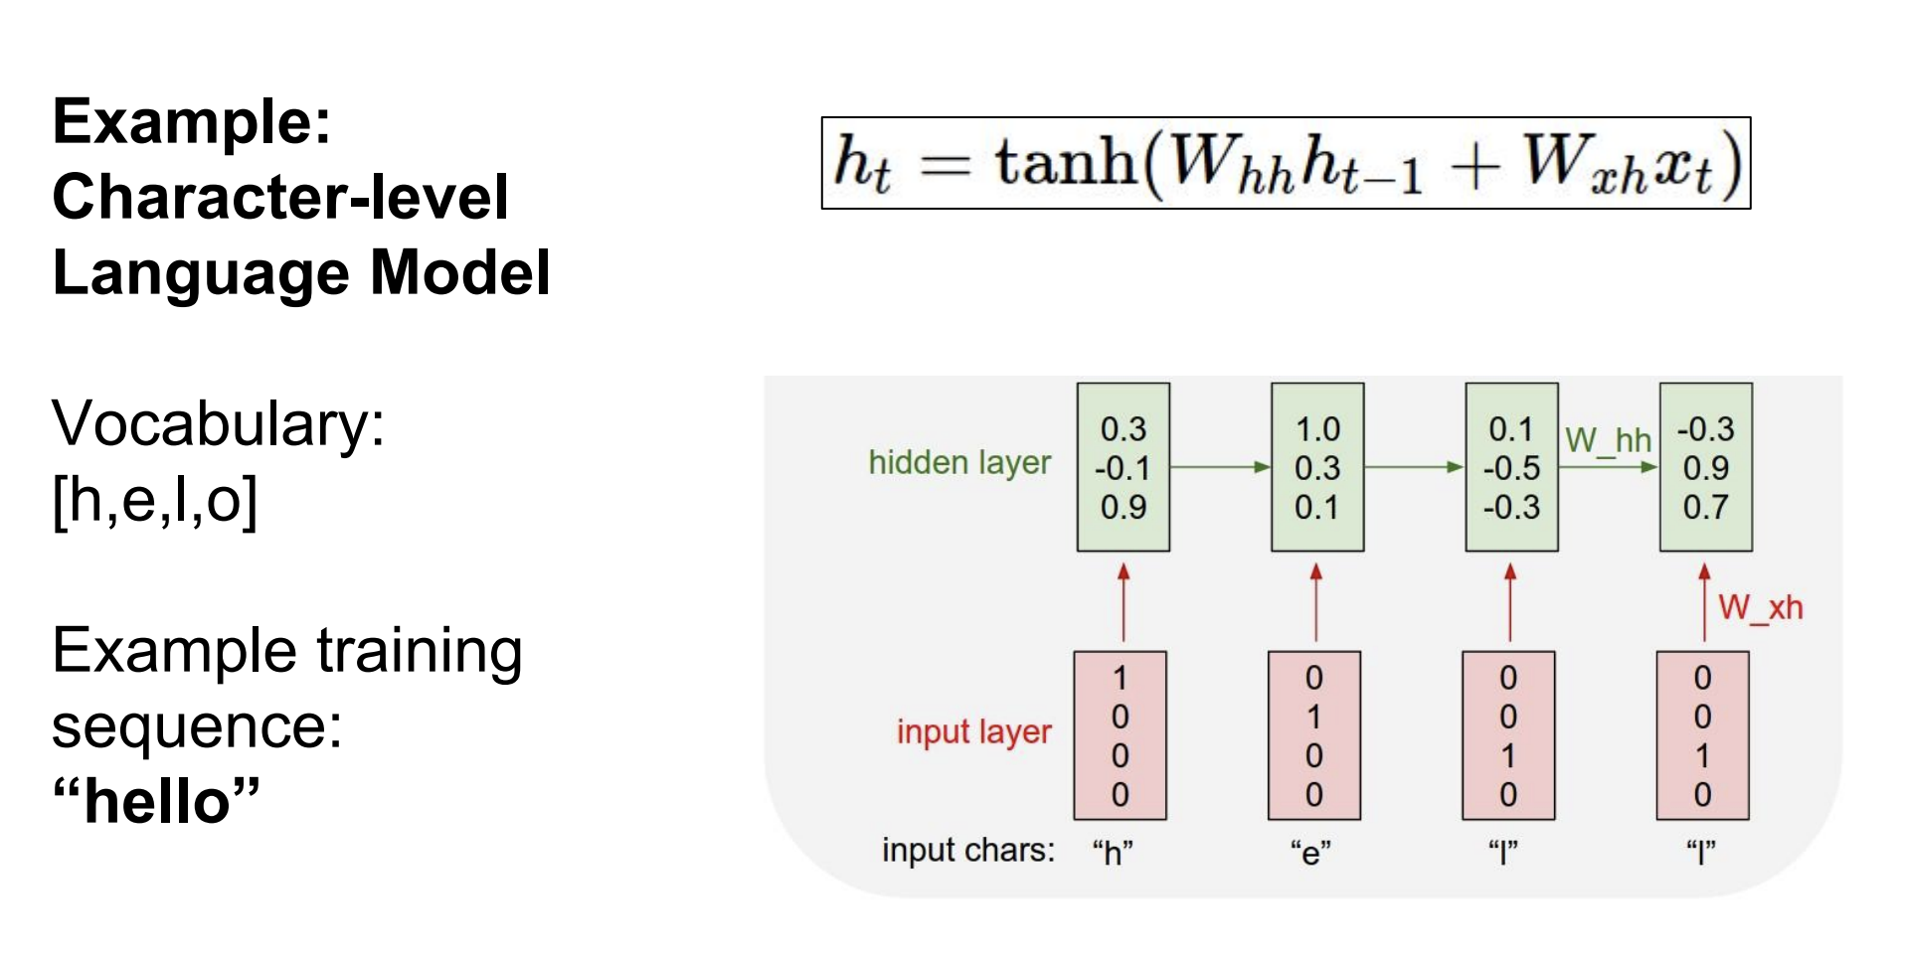

Slide 18
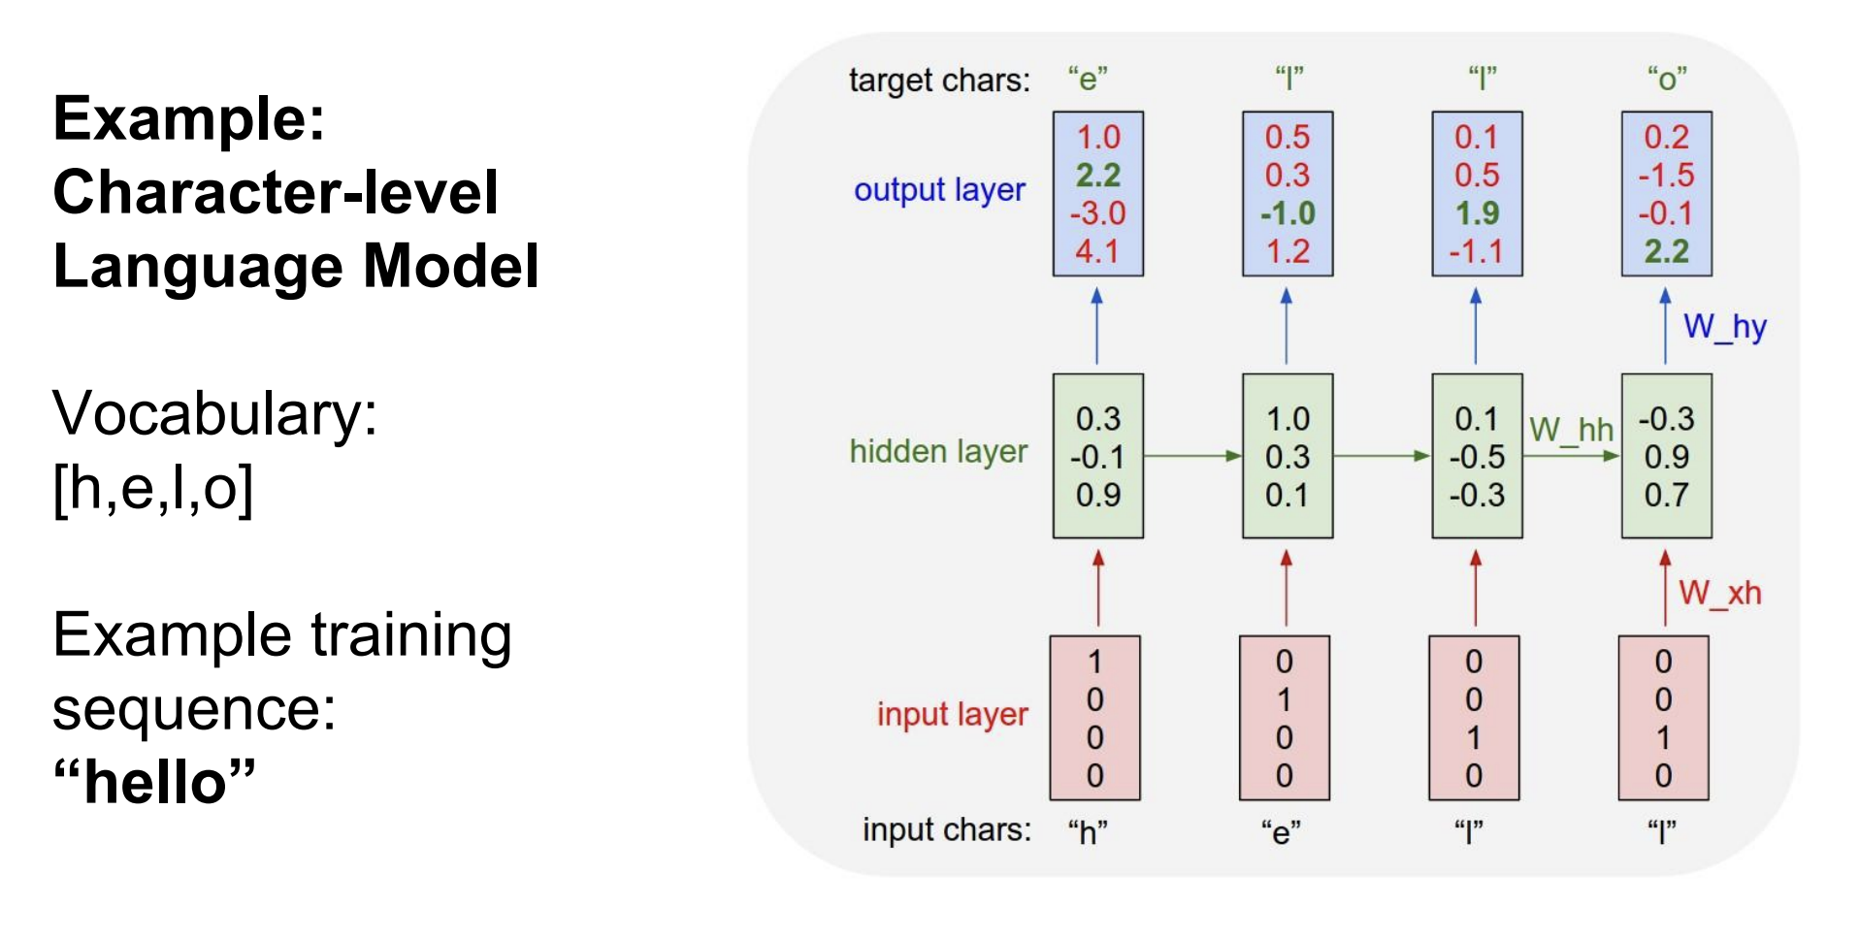

Slide 19
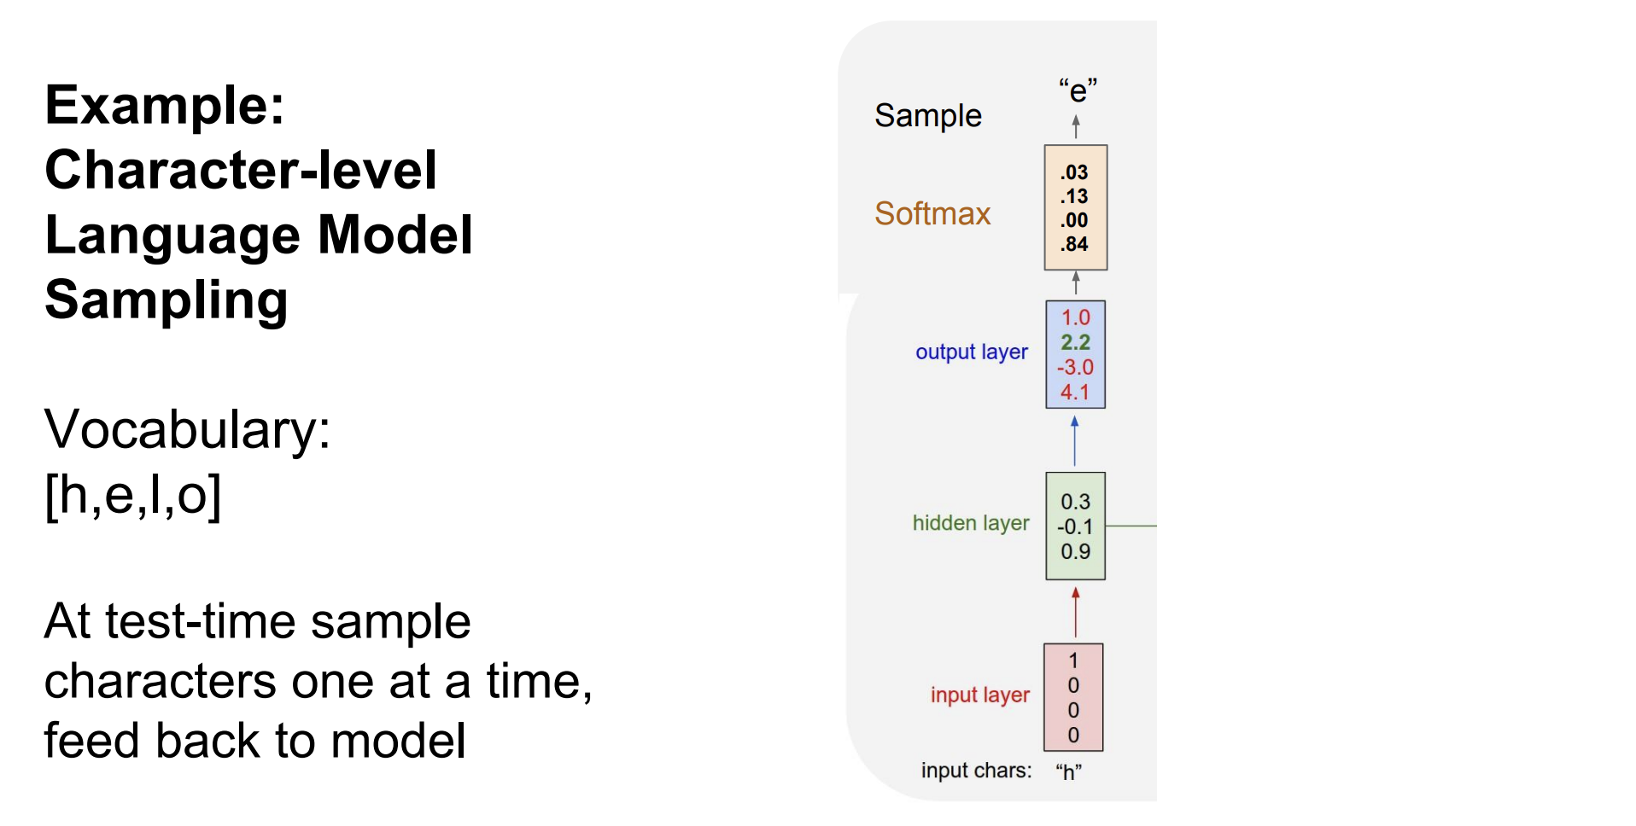

Slide 20
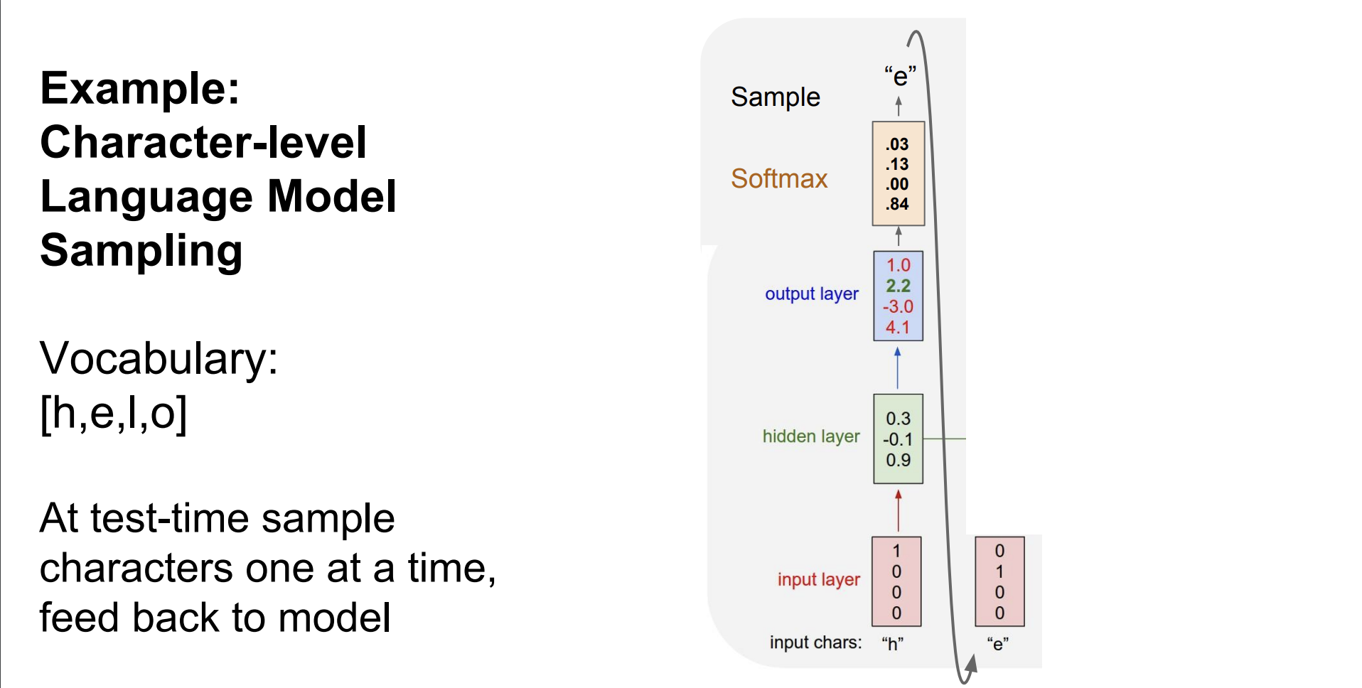

Slide 21
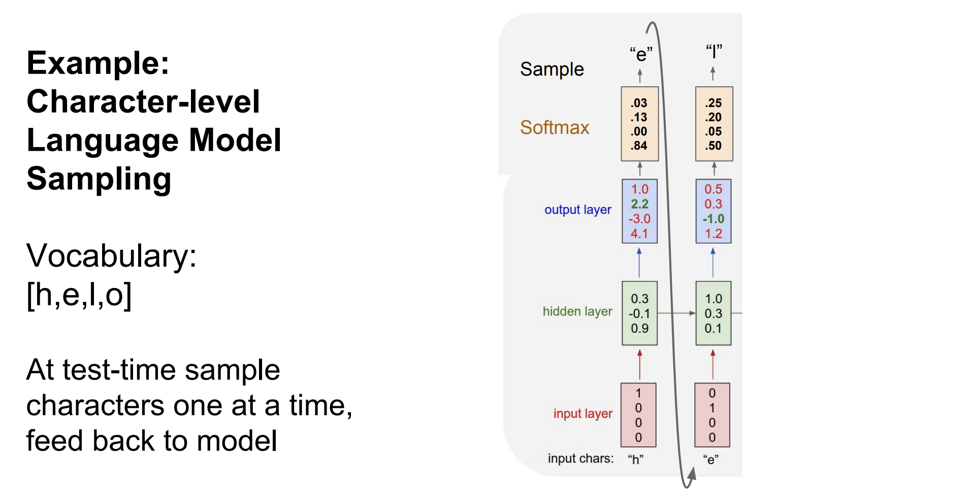

Slide 22
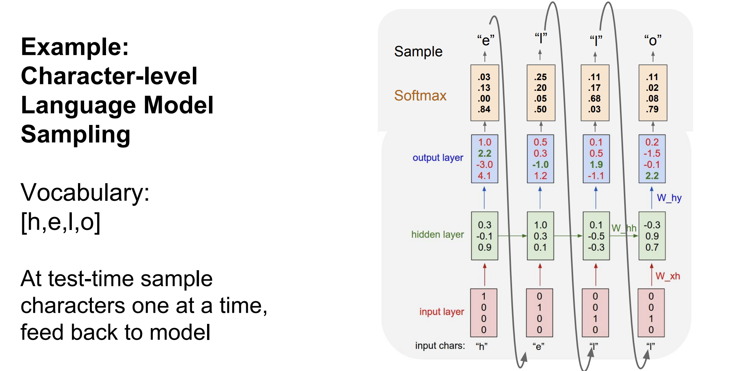

Slide 23
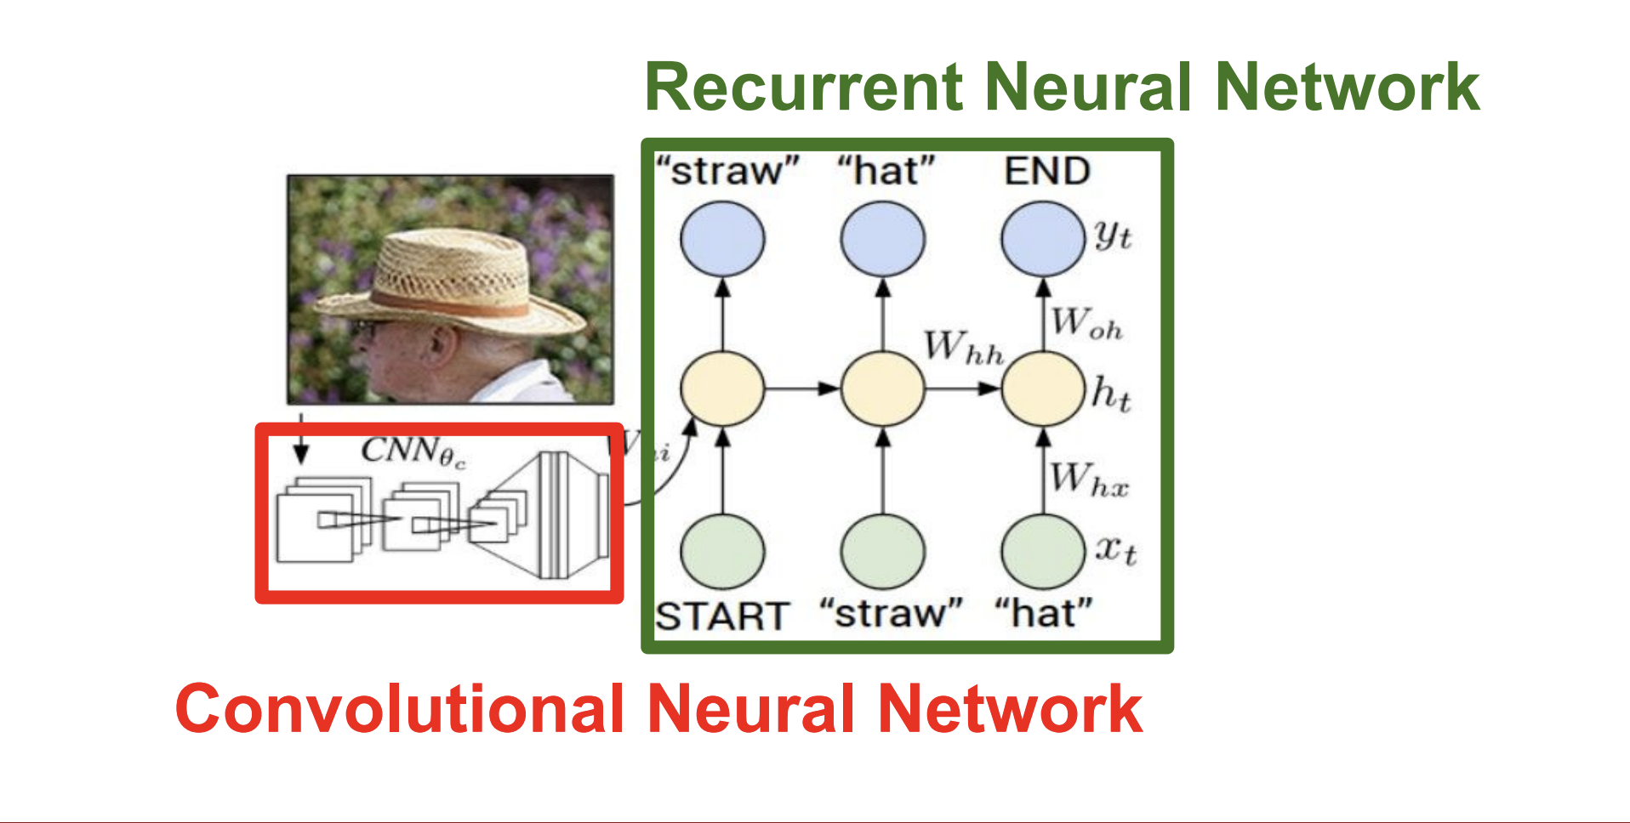

Slide 24
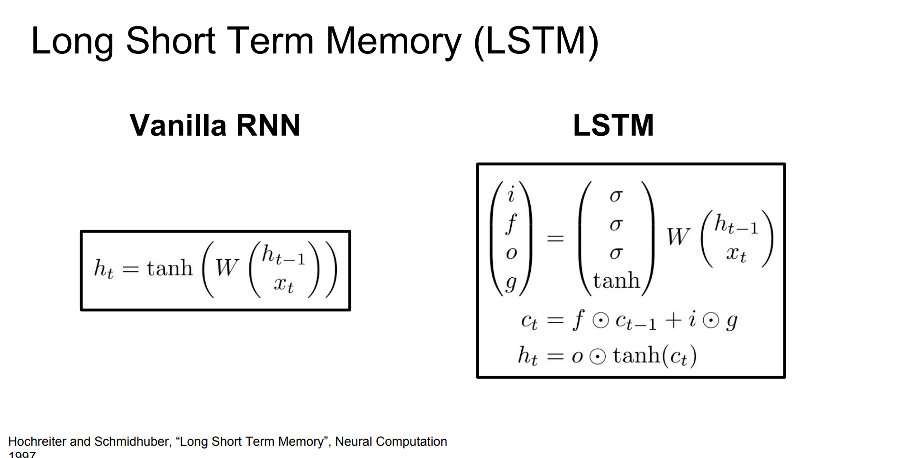

Slide 25
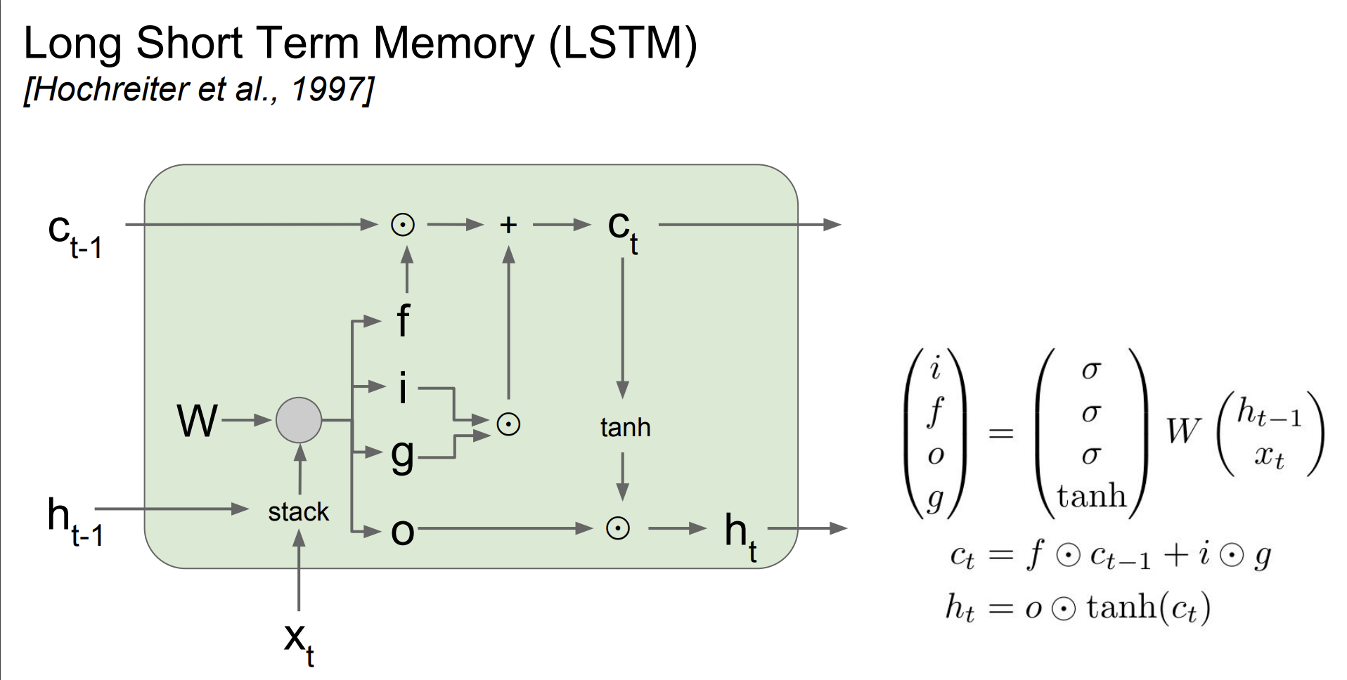

Slide 26
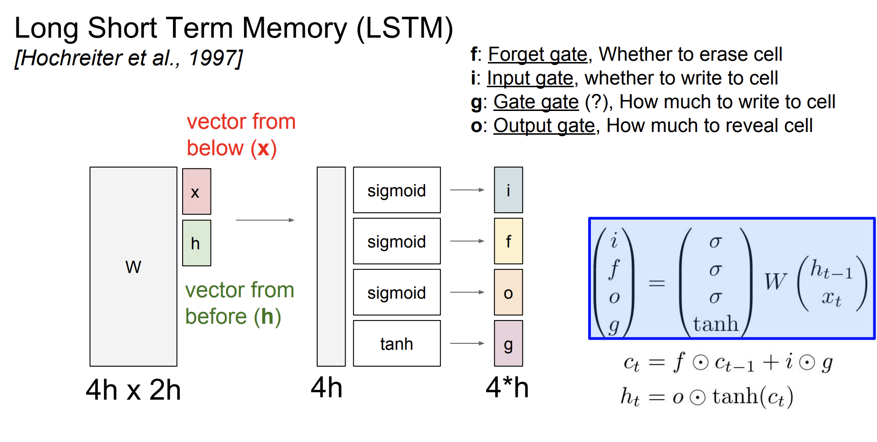

Slide 27

Thanks for watching
201920951 Dept.Software JuannKim

